Slide 1
Metric/Machine Learning Introduction
Kunlin

Slide 2
What we have learnt

Slide 3
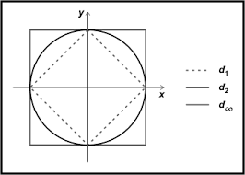
From Metric Space…

Slide 4
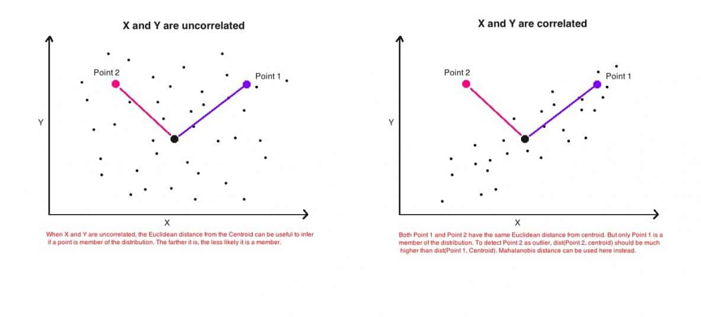
When would dn fail?

Slide 5

Where to focus?

Slide 6
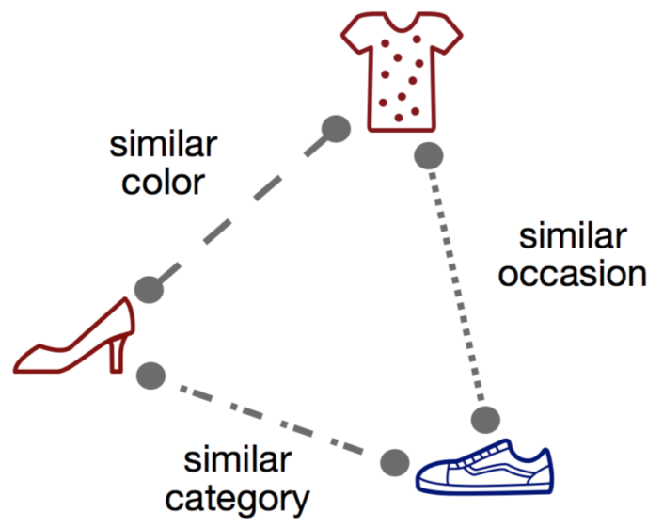
Where to focus? (cont’d)

Slide 7
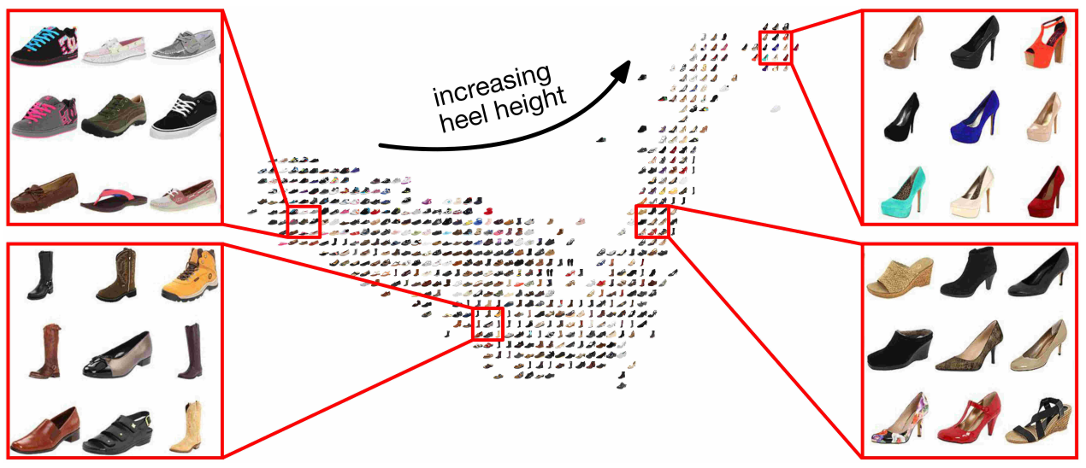
Where to focus? (cont’d)

Slide 8
Machine Learning

Slide 9
So What Is Machine Learning?
Automating automation
Getting computers to program themselves
Writing software is the bottleneck
Let the data do the work instead!

Slide 10
Traditional Programming
Machine Learning
Data
Computer
Output
Program
Data
Computer
Program
Output

Slide 11
ML in a Nutshell
Tens of thousands of machine learning algorithms
Hundreds new every year
Every machine learning algorithm has three components:
Representation
Evaluation
Optimization

Slide 12
Representation
Decision trees
Sets of rules / Logic programs
Instances
Graphical models (Bayes/Markov nets)
Neural networks
Support vector machines
Model ensembles
Etc.

Slide 13
Evaluation
Accuracy
Precision and recall
Squared error
Likelihood
Posterior probability
Cost / Utility
Margin
Entropy
K-L divergence
Etc.

Slide 14
Optimization
Combinatorial optimization
E.g.: Greedy search
Convex optimization
E.g.: Gradient descent
Constrained optimization
E.g.: Linear programming

Slide 15
ML in a Nutshell
Tens of thousands of machine learning algorithms
Hundreds new every year
Every machine learning algorithm has three components:
Representation
Evaluation
Optimization

Slide 16
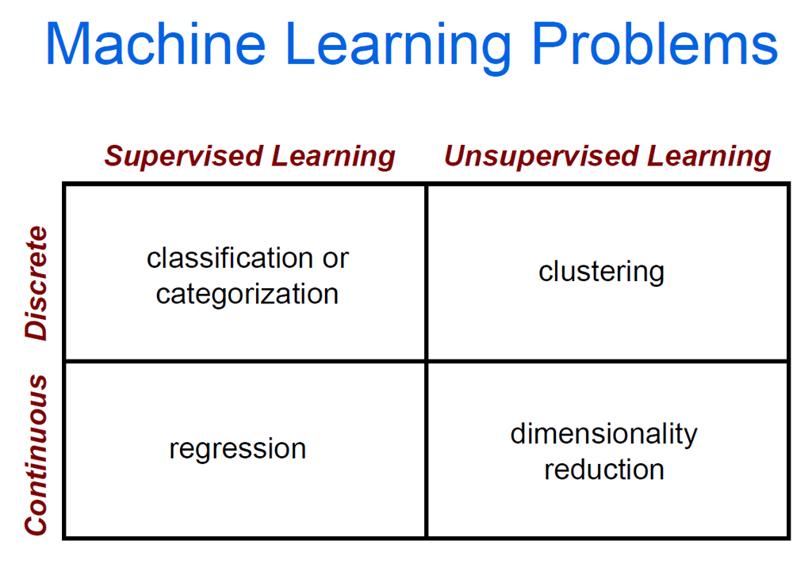

Slide 17
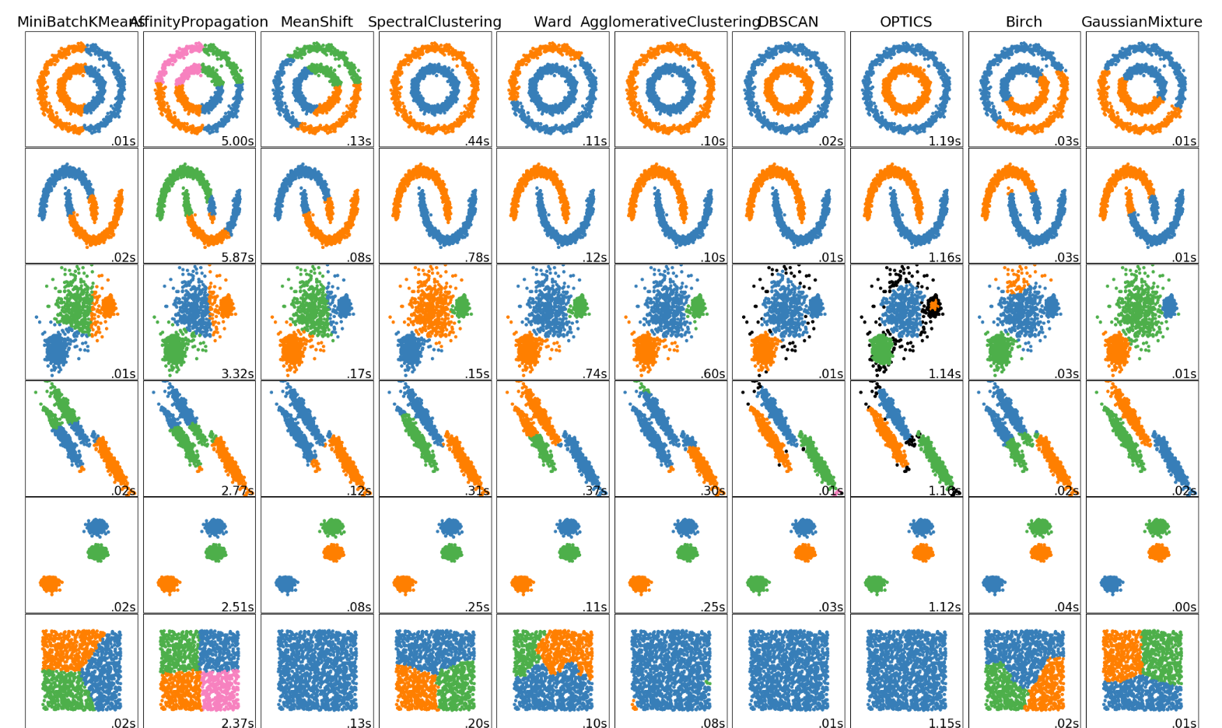
Clustering Examples

Slide 18
Clustering Strategies
K-means
Iteratively re-assign points to the nearest cluster center
Agglomerative clustering
Start with each point as its own cluster and iteratively merge the closest clusters
Mean-shift clustering
Estimate modes of pdf
Spectral clustering
Split the nodes in a graph based on assigned links with similarity weights
As we go down this chart, the clustering strategies have more tendency to transitively group points even if they are not nearby in feature space

Slide 20
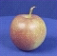
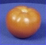
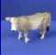
The machine learning framework
Apply a prediction function to a feature representation of the image to get the desired output:
f( ) = “apple”
f( ) = “tomato”
f( ) = “cow”
Slide credit: L. Lazebnik

Slide 21
The machine learning framework
y = f(x)
Training: given a training set of labeled examples {(x₁,y₁), …, (x_{N},y_{N})}, estimate the prediction function f by minimizing the prediction error on the training set
Testing: apply f to a never before seen test example x and output the predicted value y = f(x)
output
prediction function
Image feature
Slide credit: L. Lazebnik

Slide 22

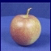
Steps
Training
Training Labels
Training Images
Image Features
Training
Learned model
Testing
Image Features
Learned model
Prediction
Test Image
Slide credit: D. Hoiem and L. Lazebnik

Slide 23
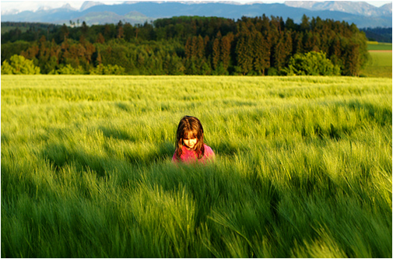
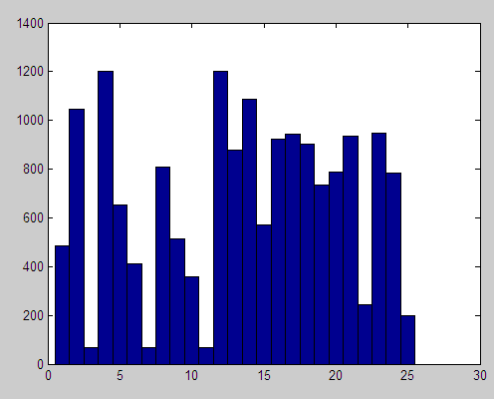
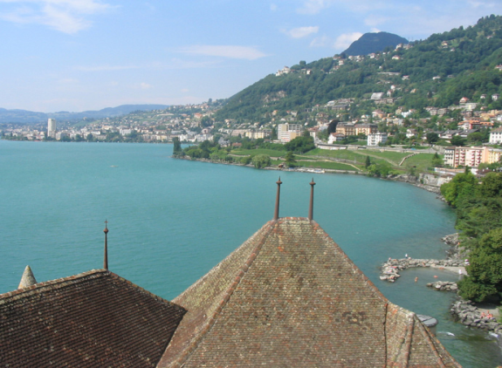
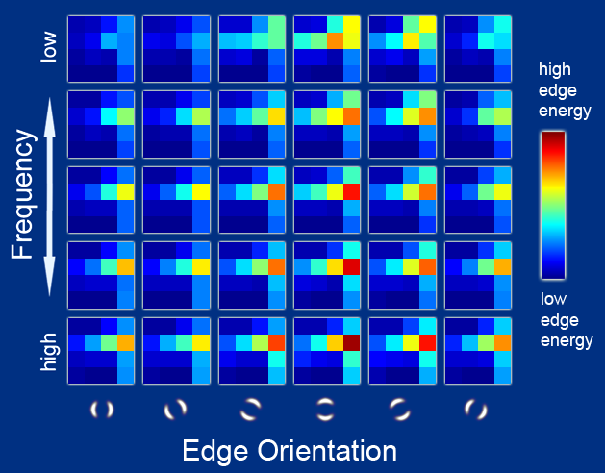
Features
Raw pixels
Histograms
GIST descriptors
…
Slide credit: L. Lazebnik

Slide 24
Classifiers: Nearest neighbor
Test example
Training examples from class 2
Training examples from class 1
f(x) = label of the training example nearest to x
All we need is a distance function for our inputs
No training required!
Slide credit: L. Lazebnik

Slide 25
Classifiers: Linear
Find a linear function to separate the classes:
f(x) = sgn(w ⋅ x + b)
Slide credit: L. Lazebnik

Slide 26
Many classifiers to choose from
Which is the best one?
SVM
Neural networks
Naïve Bayes
Bayesian network
Logistic regression
Randomized Forests
Boosted Decision Trees
K-nearest neighbor
RBMs
Etc.
Slide credit: D. Hoiem

Slide 27
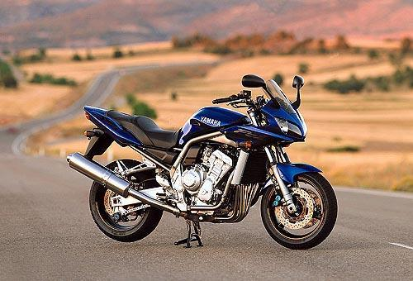
Recognition task and supervision
Images in the training set must be annotated with the “correct answer” that the model is expected to produce
Contains a motorbike
Slide credit: L. Lazebnik

Slide 28
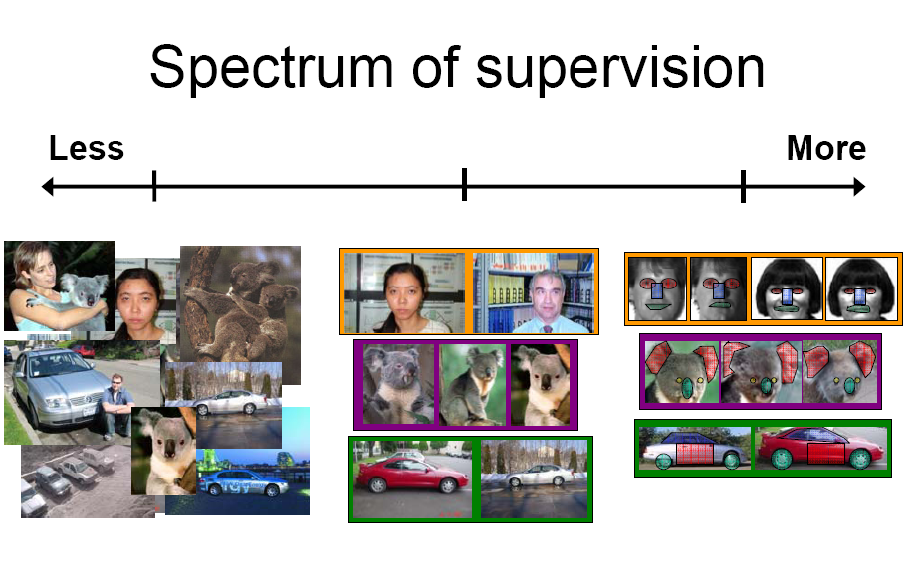
Unsupervised
“Weakly” supervised
Fully supervised
Definition depends on task
Slide credit: L. Lazebnik

Slide 29
Classifiers: Linear SVM
x
x
x
x
x
x
o
x
x
o
o
o
o
x2
x1
Find a linear function to separate the classes:
f(x) = sgn(w ⋅ x + b)

Slide 30
Classifiers: Linear SVM
x
x
x
x
x
x
o
x
x
o
o
o
o
x2
x1
Find a linear function to separate the classes:
f(x) = sgn(w ⋅ x + b)
Notes:
Maximizes a margin

Slide 31
Classifiers: Linear SVM
x
x
x
o
x
x
x
o
x
x
o
o
o
o
x2
x1
Find a linear function to separate the classes:
f(x) = sgn(w ⋅ x + b)

Slide 32
When would it fail?
Datasets that are linearly separable work out great:
But what if the dataset is just too hard?
We can map it to a higher-dimensional space:
0
x
0
x
x²
0
x
Slide credit: Andrew Moore

Slide 33
When would it fail?
General idea: the original input space can always be mapped to some higher-dimensional feature space where the training set is separable:
Φ: x → φ(x)
Slide credit: Andrew Moore

Slide 34
K-nearest neighbor
x
x
x
o
x
x
x
+
o
o
x
x
o
o
+
o
o
x2
x1

Slide 35
1-nearest neighbor
x
x
x
o
x
x
x
+
o
o
x
x
o
o
+
o
o
x2
x1

Slide 36
3-nearest neighbor
x
x
x
o
x
x
x
+
o
o
x
x
o
o
+
o
o
x2
x1

Slide 37
5-nearest neighbor
x
x
x
o
x
x
x
+
o
o
x
x
o
o
+
o
o
x2
x1

Slide 38
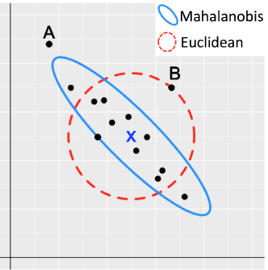
When would it fail?

Slide 39
Metric Learning

Slide 40
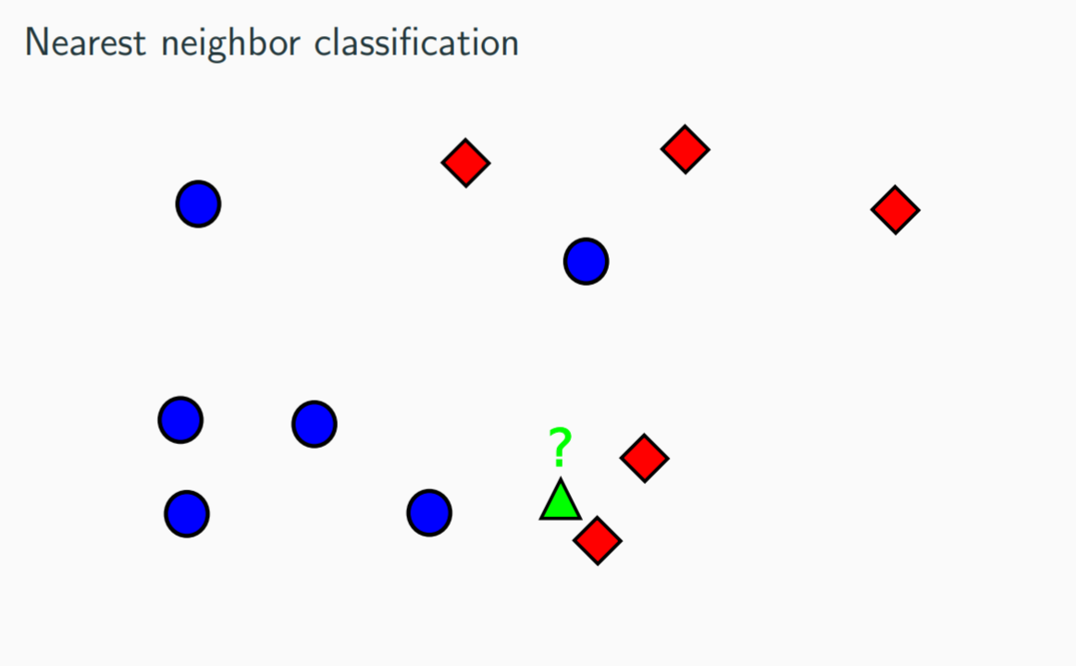
Motivation--Classification

Slide 41
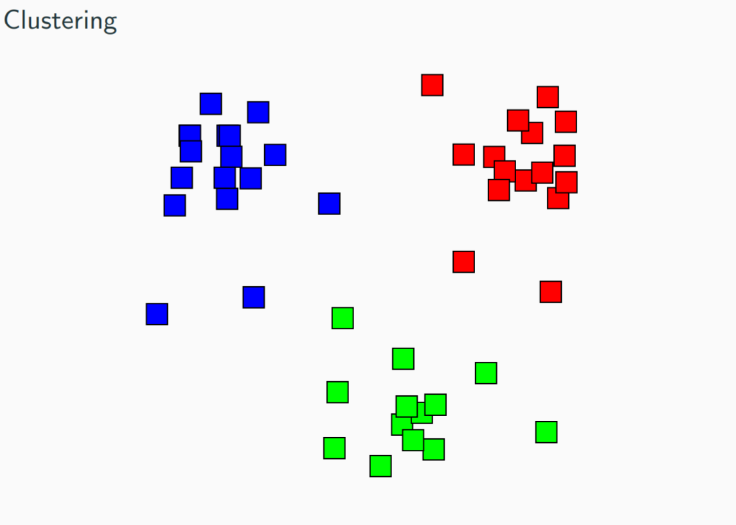
Motivation--Clustering

Slide 42
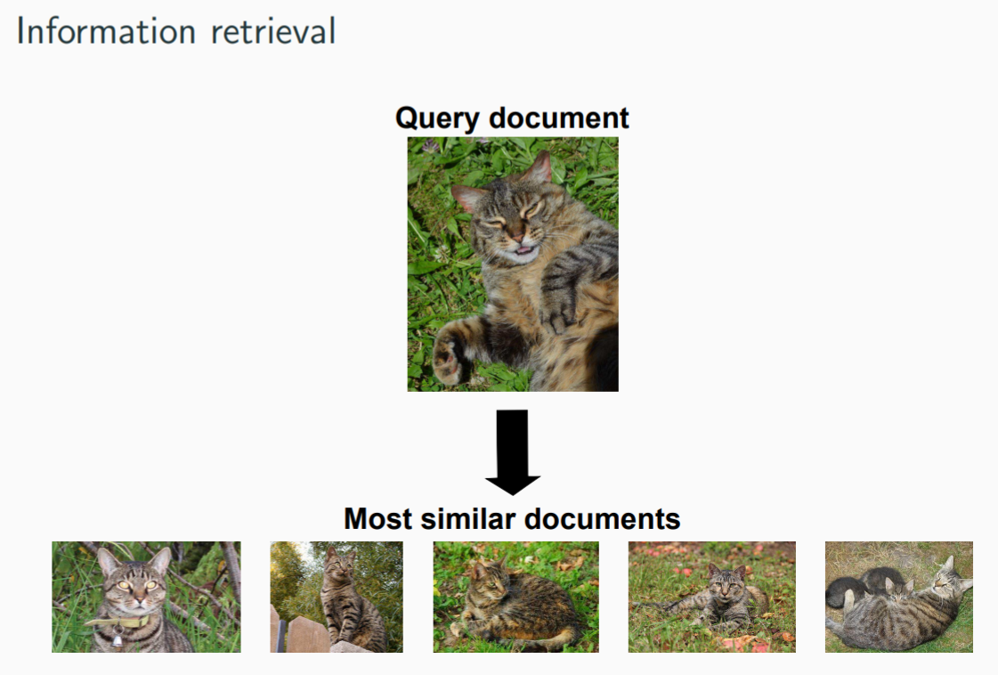
Motivation--Retrieval

Slide 43
Motivation
• Choice of similarity is crucial to the performance
• Humans weight features differently depending on context
• Facial recognition vs. determining facial expression
• Fundamental question: how to appropriately measure similarity or distance for a given task?
• Metric learning ! infer this automatically from data
• Note: we will refer to distance or similarity indistinctly as metric

Slide 44
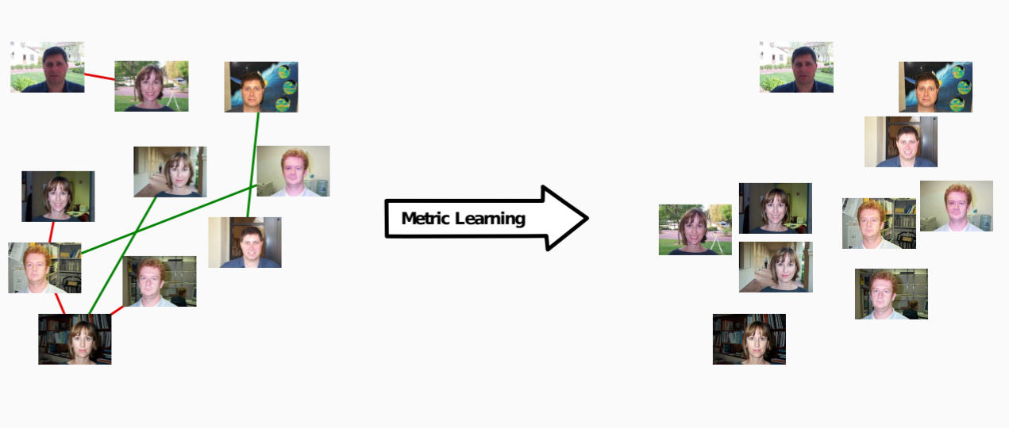
In a nutshell

Slide 45
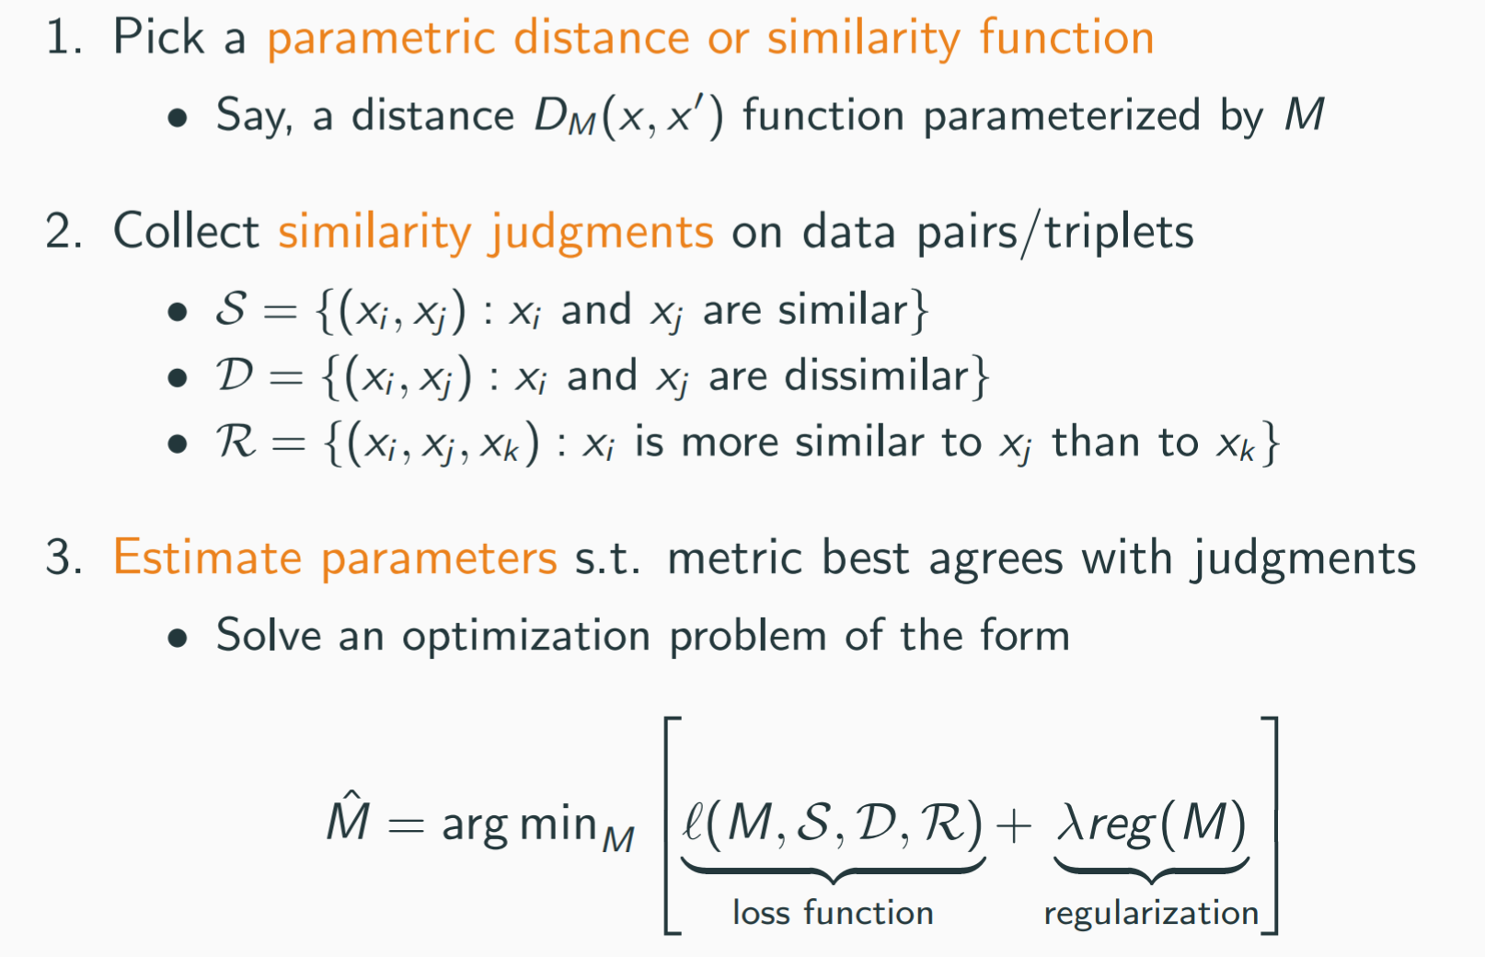
Basic recipe

Slide 46
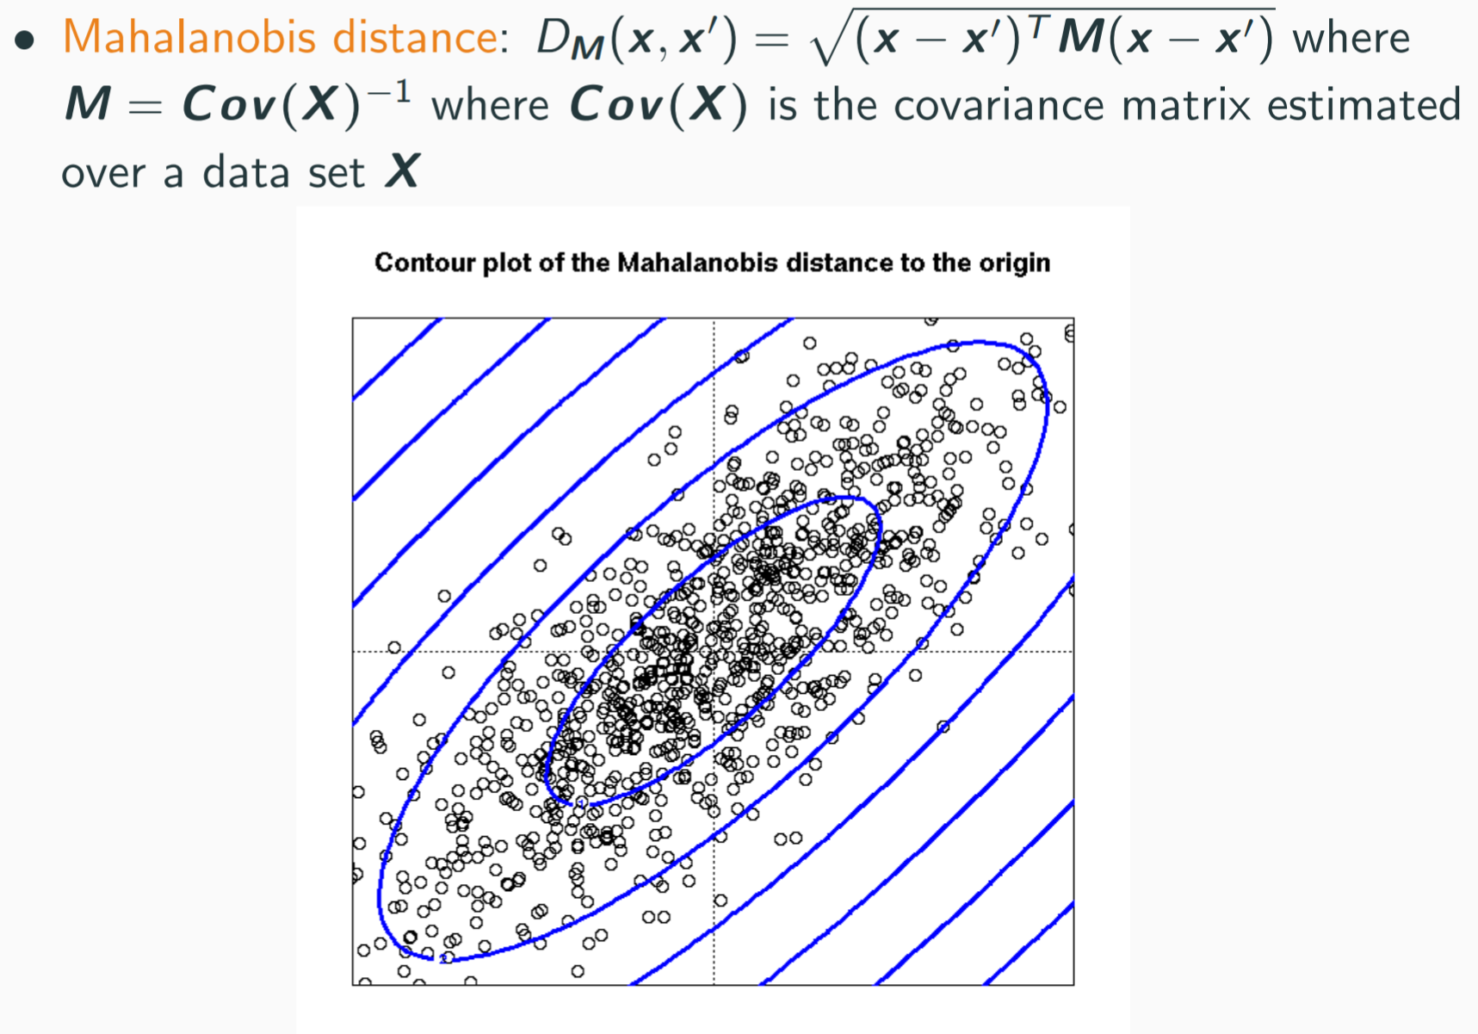
Linear condition

Slide 47
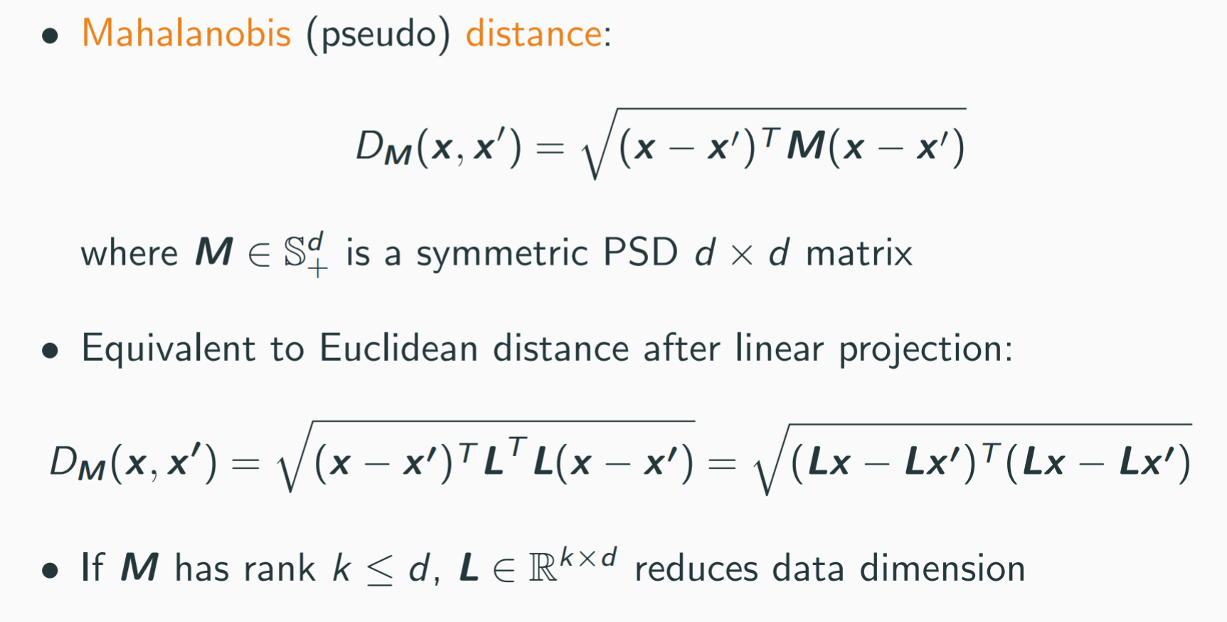
Mahalanobis distance learning

Slide 48
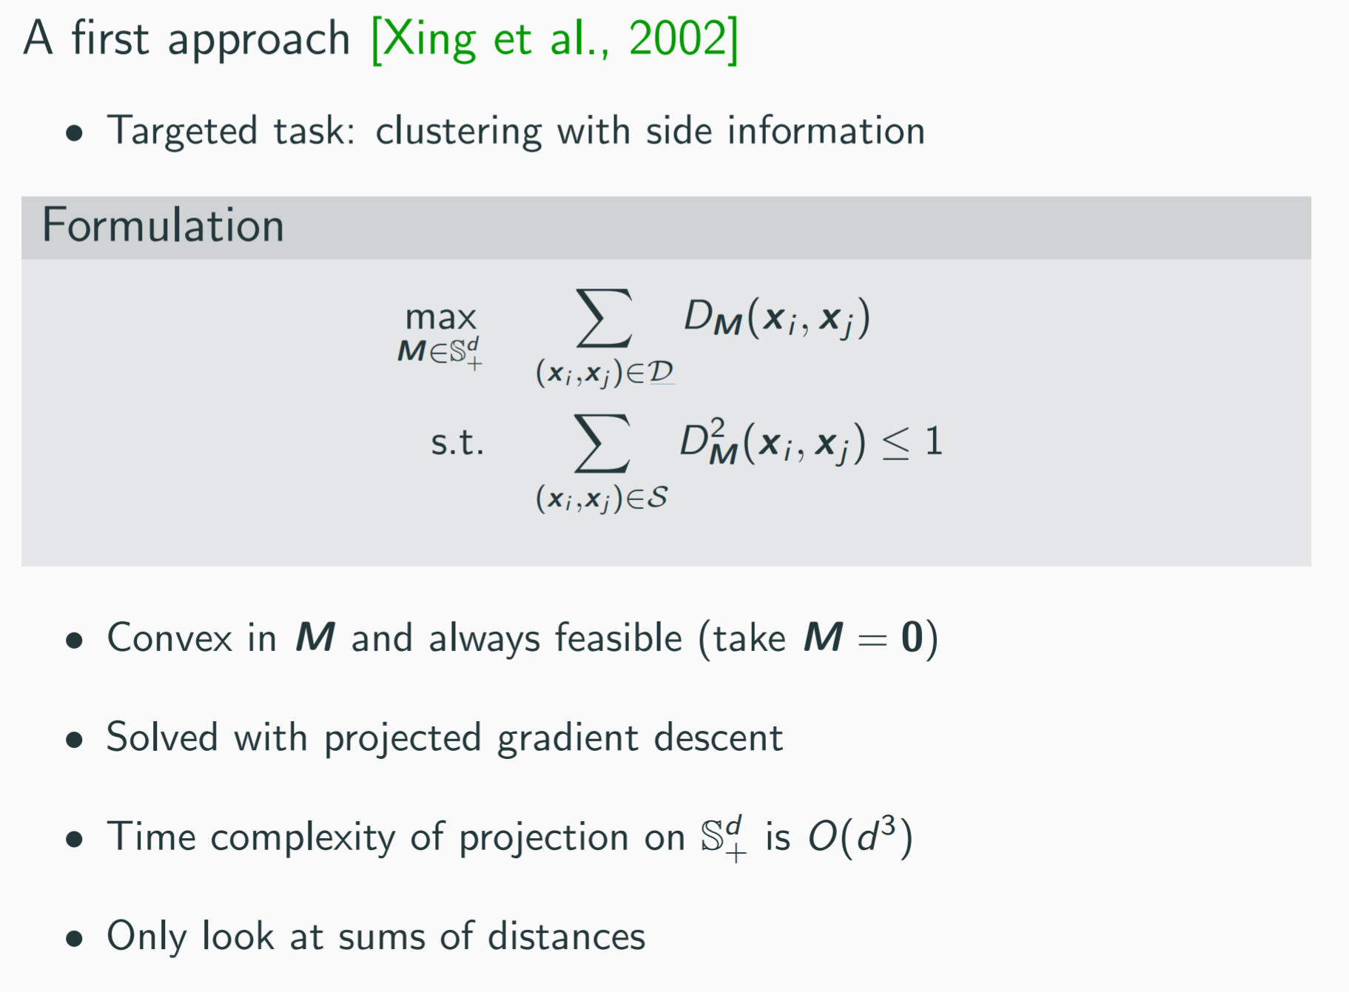

Slide 49
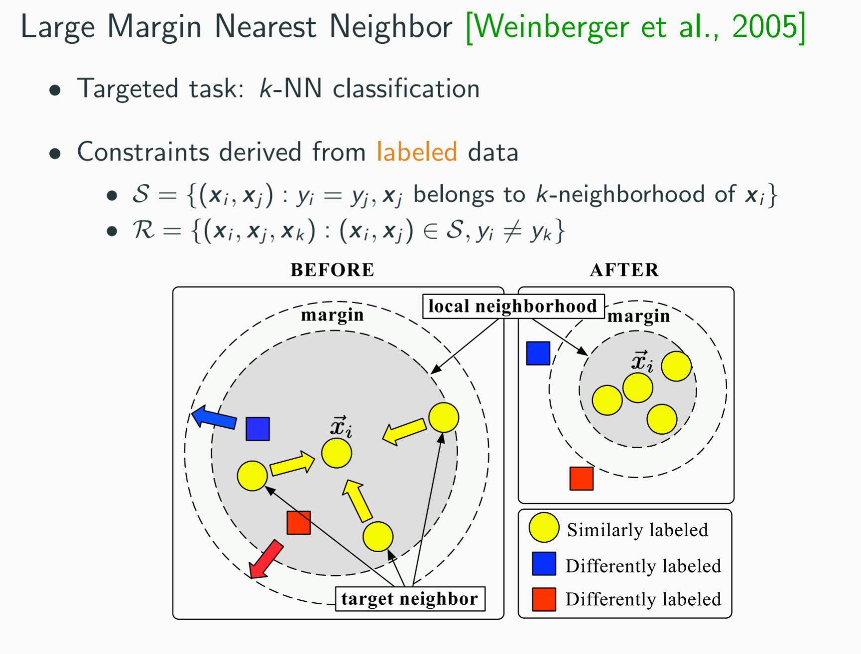

Slide 50
